Slide 1


Slide 2
Towards a Generalized Framework for Scaling-Up in Prospective Life Cycle Assessment
Marc Majó, Roland Hischier
Technology and Society Laboratory, Empa, St. Gallen, Switzerland

Slide 3
Prospective Life Cycle Assessment
Prospective LCA (pLCA) evaluates future environmental impacts of technologies before commercialization.
Uses future-oriented assumptions, scenarios, and scaling models.
Goal and Scope Definition
Life Cycle Inventory
Life Cycle Impact Assessment
Temporal, spatial scope
Functional unit
Input/output data
Future development (SSPs)
Characterization models
Impact categories
System boundaries
Scenario projections (IAM)
Interpretation

Slide 4
Prospective Life Cycle Assessment
Prospective LCA (pLCA) evaluates future environmental impacts of technologies before commercialization.
Uses future-oriented assumptions, scenarios, and scaling models.
Goal and Scope Definition
Life Cycle Inventory
Life Cycle Impact Assessment
Temporal, spatial scope
Functional unit
Input/output data
Future development (SSPs)
Characterization models
Impact categories
System boundaries
Scenario projections (IAM)
Interpretation

Slide 5
Prospective Life Cycle Assessment
Prospective LCA (pLCA) evaluates future environmental impacts of technologies before commercialization.
Uses future-oriented assumptions, scenarios, and scaling models.
Goal and Scope Definition
Life Cycle Inventory
Life Cycle Impact Assessment
Temporal, spatial scope
Functional unit
Input/output data
Future development (SSPs)
Characterization models
Impact categories
System boundaries
Scenario projections (IAM)
Interpretation
Energy/material flows at industrial level

Slide 6
Why is Upscaling Important?
Early-stage technologies (low TRL) often lack industrial-scale inventory data.
Transformation of lab-scale data to industrial-level to forecast impacts.
lab data
Industrial data
Notes:
Upscaling: Optimizing batch sizes, scaling electricity use, improved efficiency, full recovery/recycling of CO2 and methanol

Slide 7
Why is Upscaling Important?
Early-stage technologies (low TRL) often lack industrial-scale inventory data.
Transformation of lab-scale data to industrial-level to forecast impacts.
lab data
Industrial data
Laboratory Scale-up vs industrial benchmark (Dowson et al. 2012)
Scale & process | Production energy (MJ/m³) | Deviation (%) | CO₂ burden (kg CO₂/m³) | Deviation (%)
Lab-Scale | 204532 | +2414 | 6774 | +944
Upscaling | 12209 | +50 | 1429 | +120
Industrial benchmark | 8139 | - | 648 | -
Notes:
Upscaling: Optimizing batch sizes, scaling electricity use, improved efficiency, full recovery/recycling of CO2 and methanol

Slide 8
Why is Upscaling Important?
Early-stage technologies (low TRL) often lack industrial-scale inventory data.
Transformation of lab-scale data to industrial-level to forecast impacts.
lab data
Industrial data
Laboratory Scale-up vs industrial benchmark (Dowson et al. 2012)
Scale & process | Production energy (MJ/m³) | Deviation (%) | CO₂ burden (kg CO₂/m³) | Deviation (%)
Lab-Scale | 204532 | +2414 | 6774 | +944
Upscaling | 12209 | +50 | 1429 | +120
Industrial benchmark | 8139 | - | 648 | -
Notes:
Upscaling: Optimizing batch sizes, scaling electricity use, improved efficiency, full recovery/recycling of CO2 and methanol

Slide 9
Why is Upscaling Important?
Early-stage technologies (low TRL) often lack industrial-scale inventory data.
Transformation of lab-scale data to industrial-level to forecast impacts.
lab data
Industrial data
Laboratory Scale-up vs industrial benchmark (Dowson et al. 2012)
Scale & process | Production energy (MJ/m³) | Deviation (%) | CO₂ burden (kg CO₂/m³) | Deviation (%)
Lab-Scale | 204532 | +2414 | 6774 | +944
Upscaling | 12209 | +50 | 1429 | +120
Industrial benchmark | 8139 | - | 648 | -
Notes:
Upscaling: Optimizing batch sizes, scaling electricity use, improved efficiency, full recovery/recycling of CO2 and methanol

Slide 10
Why is Upscaling Important?
Early-stage technologies (low TRL) often lack industrial-scale inventory data.
Transformation of lab-scale data to industrial-level to forecast impacts.
More accurate pLCA
Assessment of novel chemicals
Support for data-poor substances
lab data
Industrial data
Laboratory Scale-up vs industrial benchmark (Dowson et al. 2012)
Scale & process | Production energy (MJ/m³) | Deviation (%) | CO₂ burden (kg CO₂/m³) | Deviation (%)
Lab-Scale | 204532 | +2414 | 6774 | +944
Upscaling | 12209 | +50 | 1429 | +120
Industrial benchmark | 8139 | - | 648 | -
Notes:
Upscaling: Optimizing batch sizes, scaling electricity use, improved efficiency, full recovery/recycling of CO2 and methanol

Slide 11
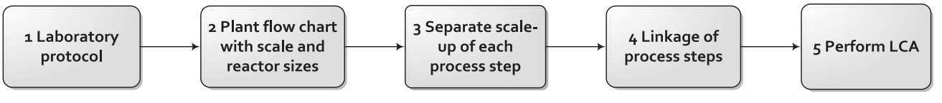
Why is Upscaling Important?
No clear guideline on upscaling procedures
Limited comparability and reproducibility
More time consuming
Generalized Scale-up framework
Scale-up framework (Piccinno et al. 2016)

Slide 12
Objective
Develop an understanding and standardization path for lab-to-industrial-scale upscaling methodologies in pLCA.
Critical upscaling variables
Minimum data requirements
Guidelines for a generalized upscaling framework

Slide 13
1. Literature review of upscaling methods
Categorization of different upscaling methodologies and trends
AI-powered literature review:
  Boolean operators applied to identify relevant publications
  LLM tools used for identification of the upscaling methodology
  Network visualization tools used for mapping

Slide 14
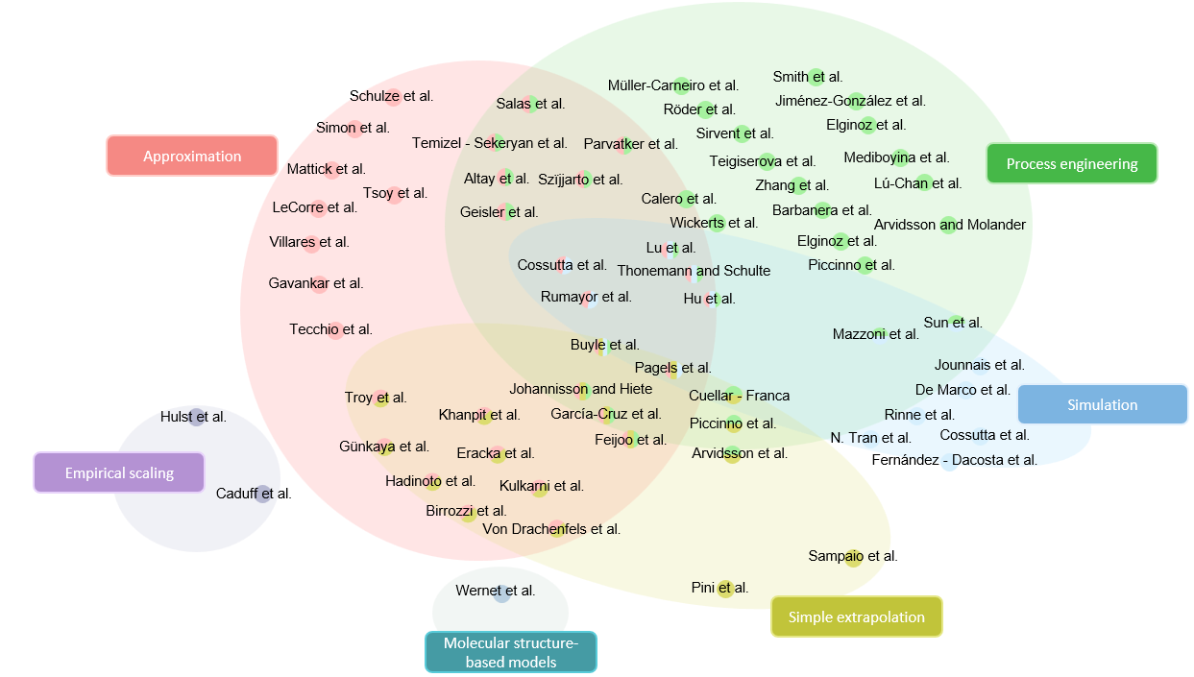
1. Literature review of upscaling methods

Slide 15
1. Literature review of upscaling methods
Simulation
(detailed process modeling)
Process engineering
(mathematical equations and stoichiometric relationships)
Empirical scaling
(experimental data to derive empirical correlations)
Approximation
(data from analogous, pre-existing technologies)
Simple extrapolation
(linear or non-linear extrapolation techniques)
Molecular structure-based models

Slide 16
1. Literature review of upscaling methods
Data requirements
Simulation
(detailed process modeling)
Process engineering
(mathematical equations and stoichiometric relationships)
Empirical scaling
(experimental data to derive empirical correlations)
Approximation
(data from analogous, pre-existing technologies)
Simple extrapolation
(linear or non-linear extrapolation techniques)
Molecular structure-based models

Slide 17
1. Literature review of upscaling methods
Data requirements
Simulation
(detailed process modeling)
Process engineering
(mathematical equations and stoichiometric relationships)
Empirical scaling
(experimental data to derive empirical correlations)
Approximation
(data from analogous, pre-existing technologies)
Simple extrapolation
(linear or non-linear extrapolation techniques)
Molecular structure-based models
Challenges
Data scarcity
High uncertainty
Variability
Limitations
Lack of reproducibility
Absence of standardized procedures
Need for a universal procedure

Slide 18
1. Literature review of upscaling methods
Methodology | Data Requirements
Simulation | Detailed input specifications Reaction mechanisms Phase equilibria Mass & energy flows Software licenses
Process Engineering | Stoichiometry Reactor parameters Energy balances Reaction kinetics Thermodynamic constants
Empirical Scaling | LCA data from multiple scales Cost and learning curves Historical performance metrics
Methodology | Data Requirements
Approximation | Reference tech/process data Analogous LCI datasets Qualitative understanding of processes
Simple Extrapolation | Lab-scale data Scaling factors (from literature or proxies) Basic material and energy flows
Molecular Structure-Based Models | Molecular descriptors Structural info (e.g. bonds, groups) Trained neural network/database
Notes:
• Simulation: high accuracy, needs detailed inputs
• Empirical: easy to apply, data-intensive, less precise
• Approximation: fast, but high uncertainty
• Process Engineering: mechanistic, needs process knowledge
• Structure-based: innovative, used for novel substances

Slide 19
2. Towards a generalized upscaling process
Identification of critical scaling drivers
Sectoral standardization guidelines
Energy Flows: Non-linear scaling
Material inputs: Optimization and recycling
Waste & Emissions: Advanced treatment systems
Infrastructure Impact: Significant at industrial scale
Biochemical
Petrochemical
Pharmaceutical
Food processing
Metallurgic

Slide 20
2. Towards a generalized upscaling process
Identification of critical scaling drivers
Sectoral standardization guidelines
Energy Flows: Non-linear scaling
Material inputs: Optimization and recycling
Waste & Emissions: Advanced treatment systems
Infrastructure Impact: Significant at industrial scale
Biochemical
Petrochemical
Pharmaceutical
Food processing
Metallurgic
Critical upscaling variables

Slide 21
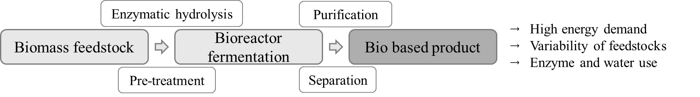
2. Towards a generalized upscaling process
Biochemical sector
Critical upscaling variables
Notes:
1. Biochemical (Bioreactor-Centered)
Focus: Fermentation & enzymatic conversion
Reactor Sizing:
Working volume, cycles/day or flow rate
Product yield per volume (g·L⁻¹ or g·L⁻¹·h⁻¹)
Mass & Energy Transfer:
Oxygen transfer (aeration rate, kLa)
Agitation (power input, impeller speed)
Cooling/heating duty (kW or MJ·h⁻¹)
Downstream Processing:
Centrifuges/filters: flow rate, solids loading, G-force
Membranes: area, flux
Pretreatment & Hydrolysis:
Solid throughput, residence time
Energy demand for milling/heating

Slide 22
2. Towards a generalized upscaling process
Method operation identification
Clear data requirements
Coverage of all process stages
Minimum data gathering depending on method
Simulation
Process engineering
Empirical scaling
Approximation
Simple extrapolation
Molecular models

Slide 23
2. Towards a generalized upscaling process
Method operation identification
Clear data requirements
Coverage of all process stages
Minimum data gathering depending on method
Simulation
Process engineering
Empirical scaling
Approximation
Simple extrapolation
Molecular models
Minimum data requirements

Slide 24
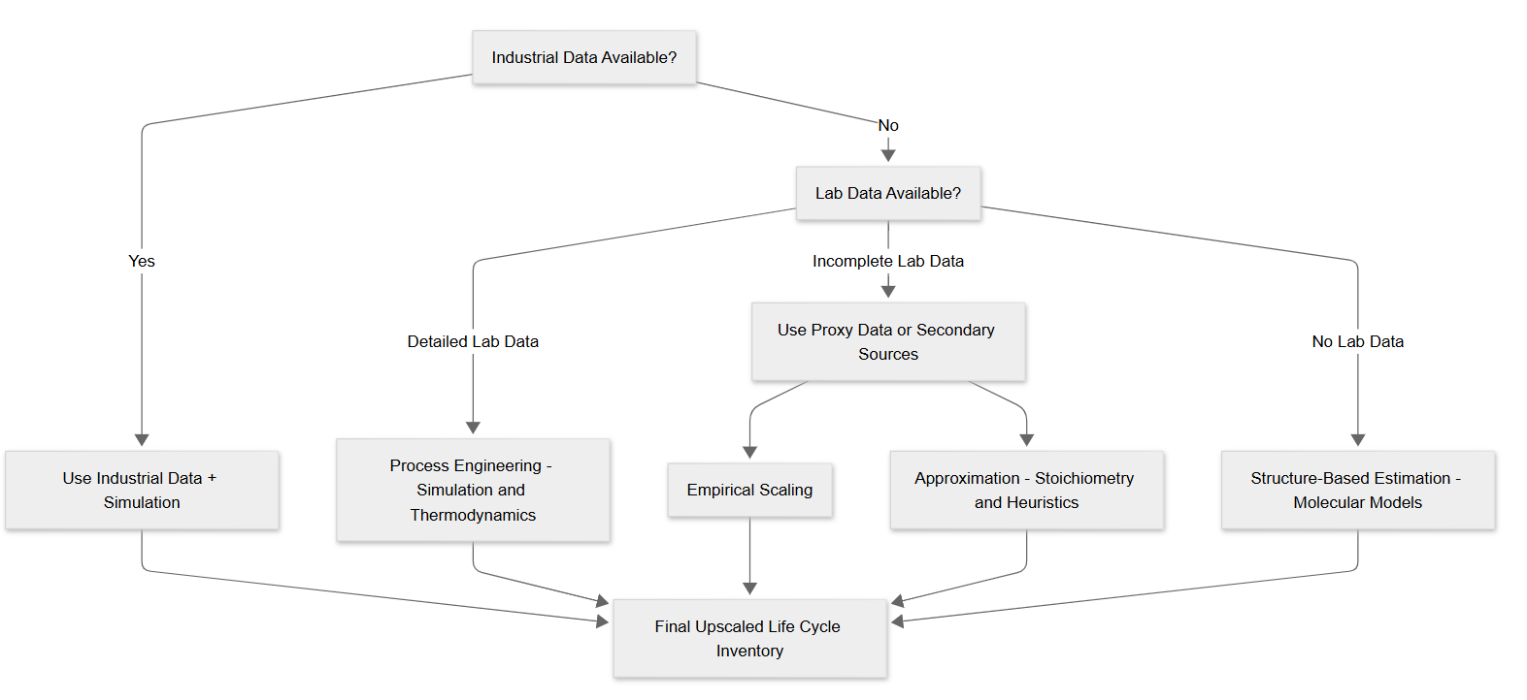
2. Towards a standardized upscaling
Method operation identification

Slide 25
3. Conclusions & Future Work
Identification of critical scaling drivers
Sectoral standardization
Upscaling methodology selection
Improving accuracy in LCIA
Better selection and execution of methodology
Guidelines for a generalized upscaling framework
Future work
Development of guidelines and requirements for upscaling
Case study implementation – Complete LCI

Slide 26




marc.majo@empa.ch
The PINK Project has received funding from:
The European Union’s Horizon Europe Research and Innovation programme under grant agreement No. 101137809.
Innovate
UK

